Slide 1
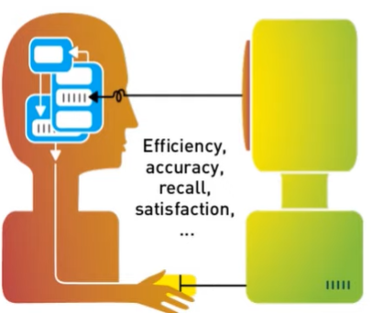
Multidisciplinary Fields and User Centered Design in Human Computer Interaction

Slide 2
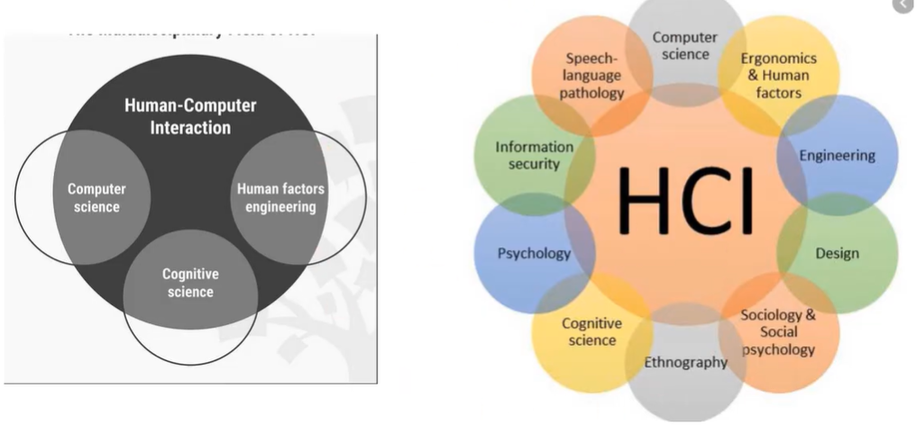
Multidisciplinary Fields in HCI

Slide 3
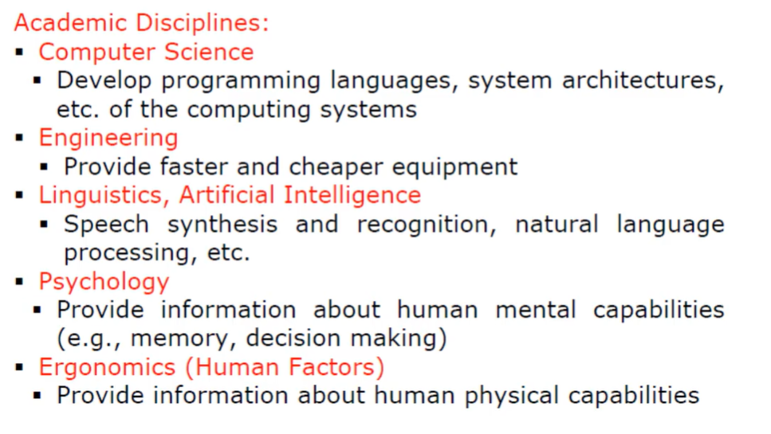
Disciplines Contribute to HCI

Slide 4
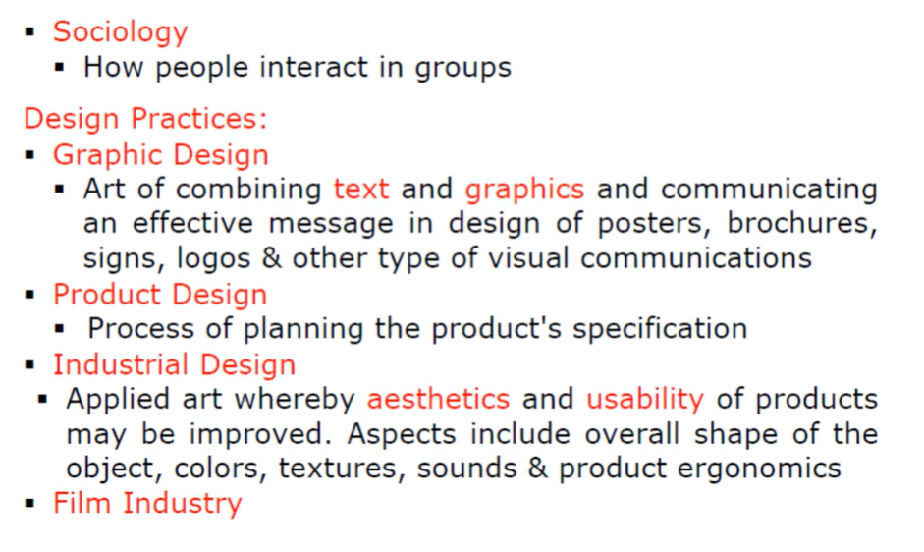
Disciplines Contribute to HCI

Slide 5
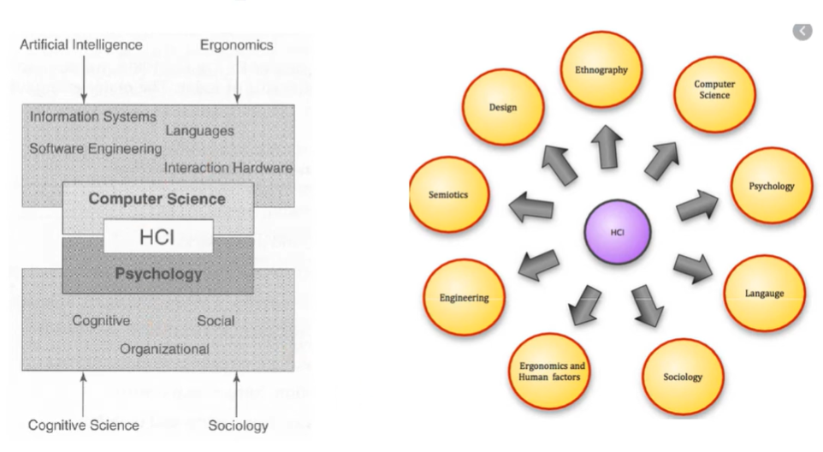
Disciplines Contribute to HCI

Slide 6
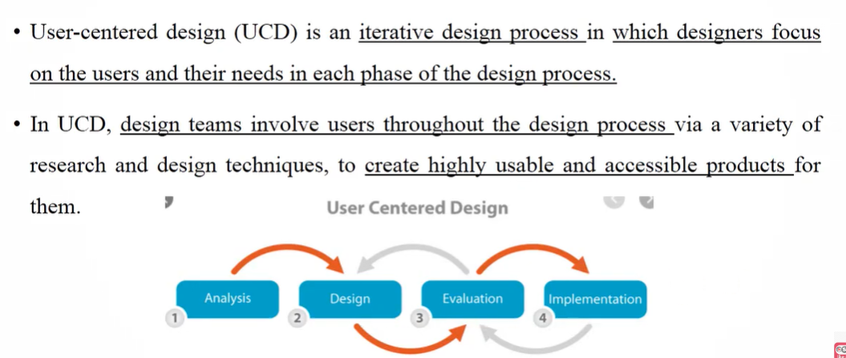
User Centered Design

Slide 7
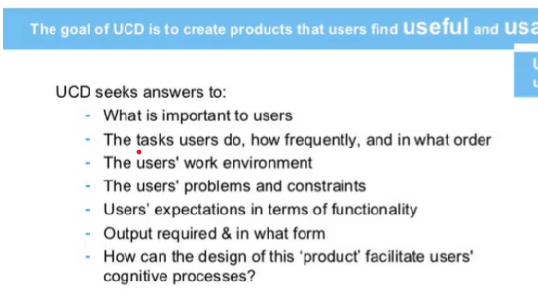
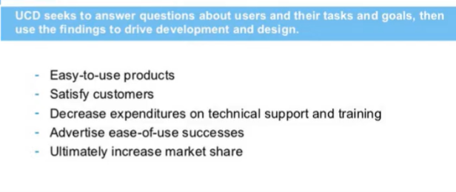
Why User Centered Design?

Slide 8
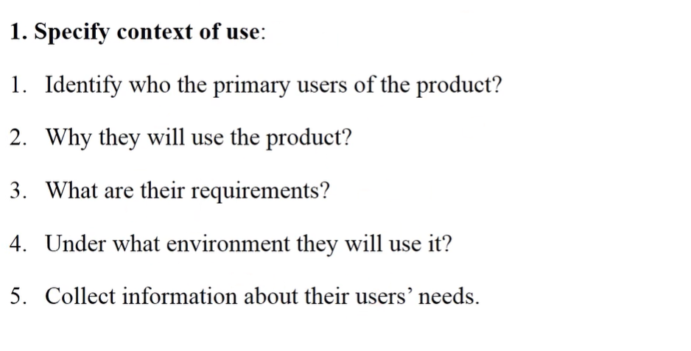
User Centered Design Process 1

Slide 9
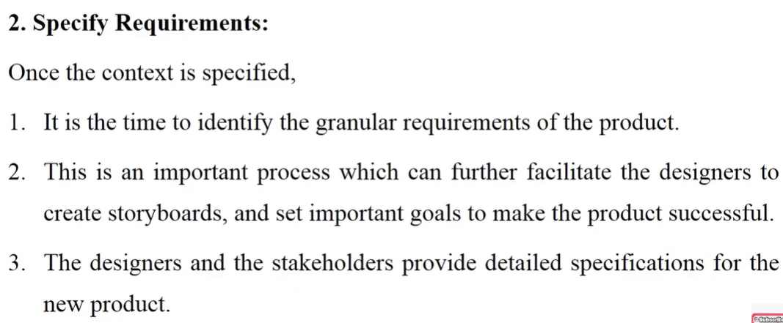
User Centered Design Process 2

Slide 10
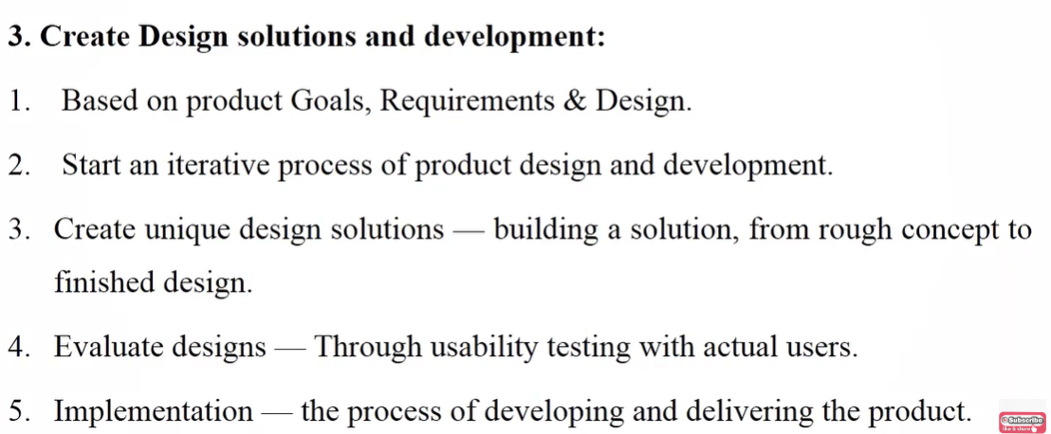
User Centered Design Process 3

Slide 11
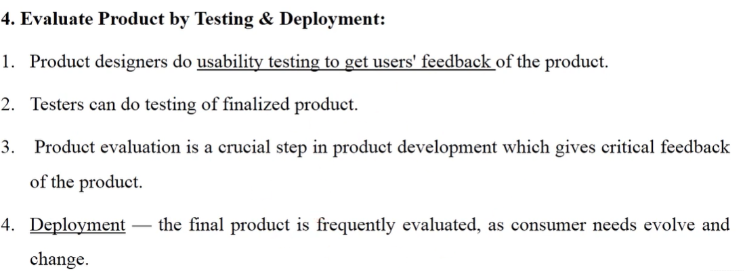
User Centered Design Process 3

Slide 12
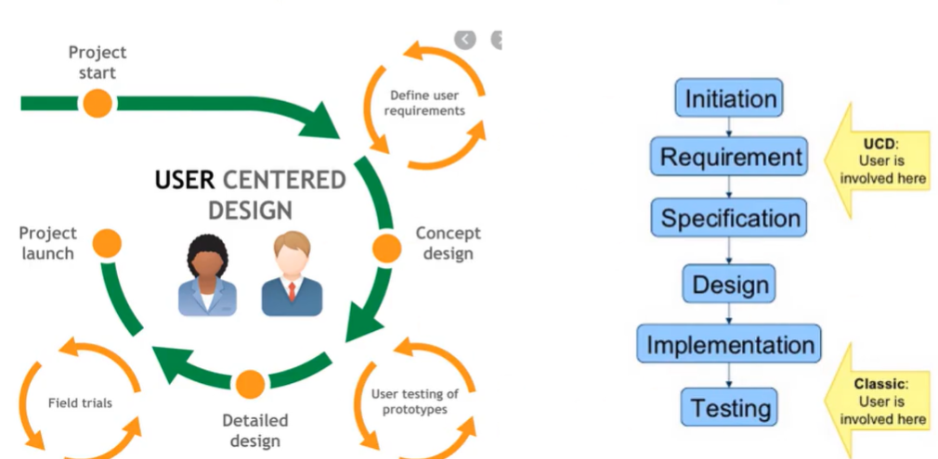
Example of User Centered Design

Slide 13
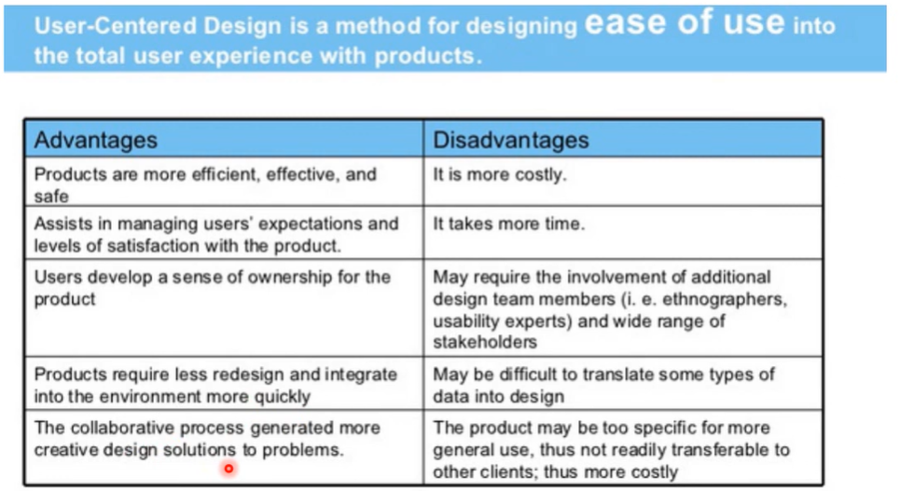
Advantages and Disadvantages of UCD

